Slide 1

Melbourne House Market – Technical Presentation
Mehmet Tiras – December 2020

Slide 2
Amid chronic diseases and the declining global economy push the company to search for new business opportunities for 2% profit in 2019.
Necessities to find a profitable market in the real estate sector draw us to decide will the Melbourne real estate market thrive for our company. | To understand this problem, we must prove the market that it has enough high-volume capacity. Hence, if it has, we must convey a strategy on how to achieve the company’s targeted profit as 2% for $100 billion.

Slide 3
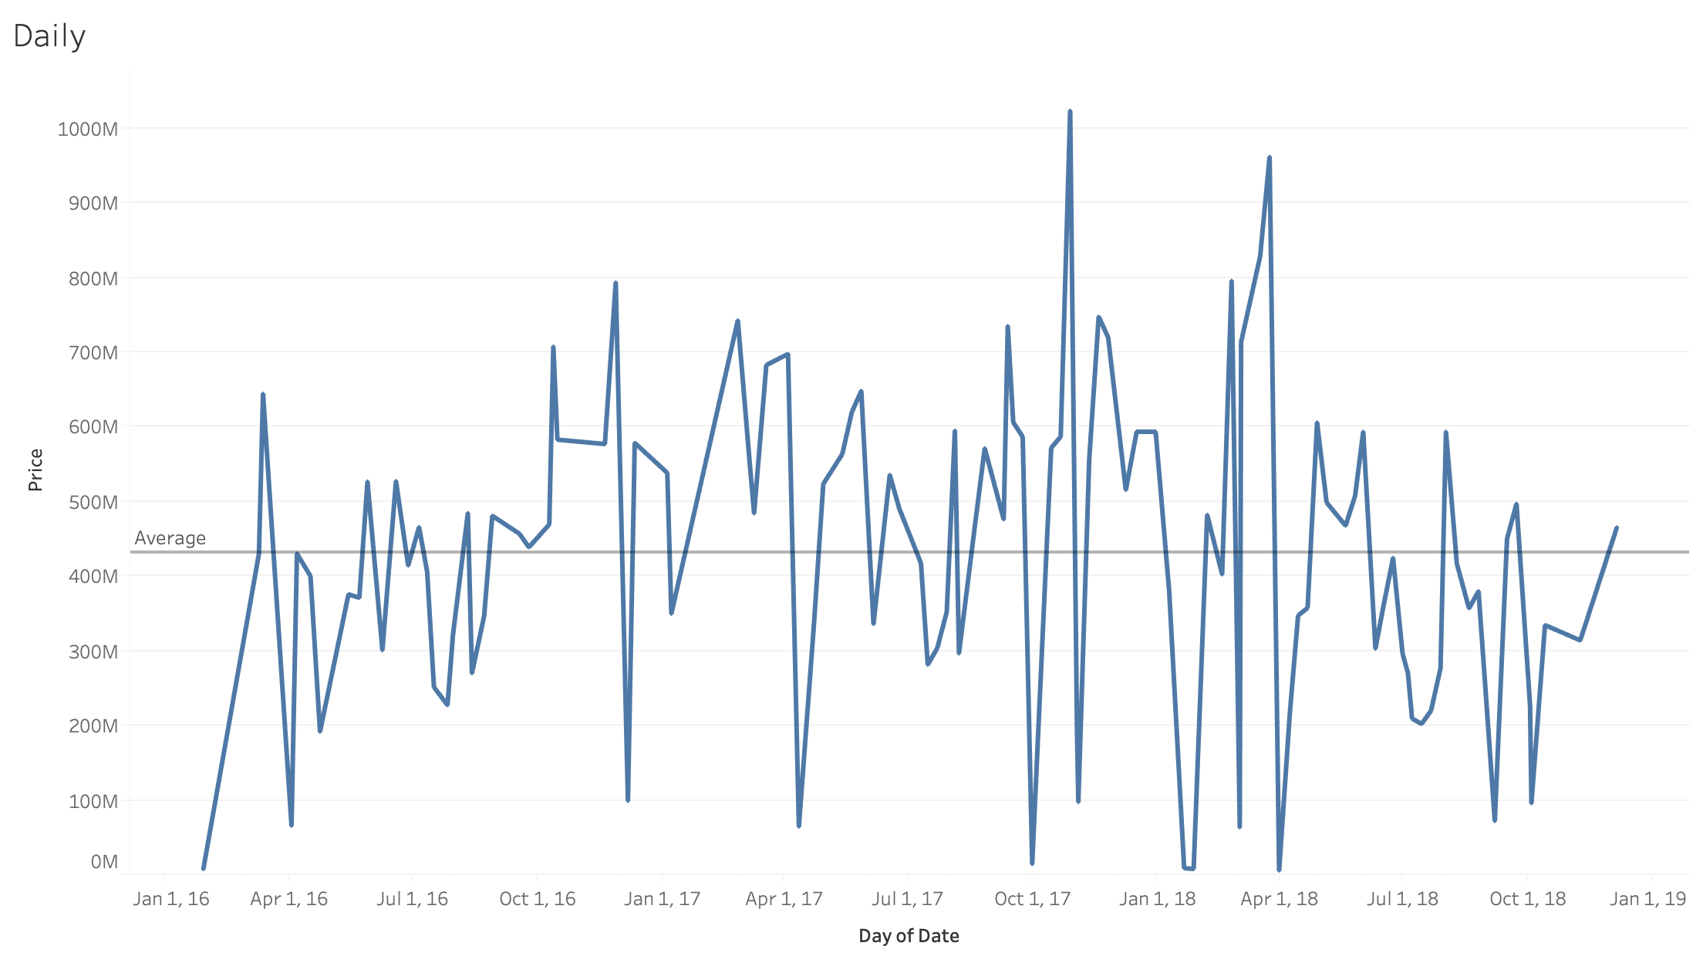
The market’s turnover is $48 billion for three years. Tableau proves that the market’s sales volume is big enough to invest in. This helps in reducing costs and increasing profitability in terms of sales graphics.
The market's three-year average is $16 billion. Thus, it is a vivid one to reach out to the company’s profit target.
The market will serve as a safe harbor for the company among global up and downs with respect to its high capacity.

Slide 4
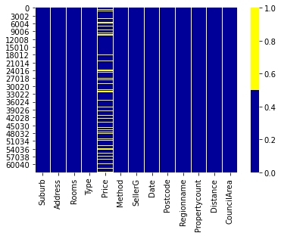
The clarity market’s data shows the missing data proportion is quite low in the price column (23%). The other columns are %0. Hence acquired results are convincing.
Yellow is missing values

Slide 5
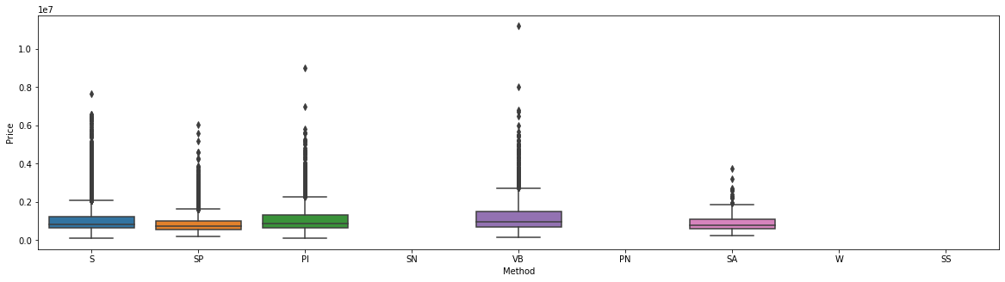
When we look at the method column in our data set, there is no withdrawn (W). Hence, all types of sale must count as sold property. Boxplot proves the best price range options, which will help to raise the company's turnover.
S - property sold;
SP - property sold prior;
PI - property passed in;
PN - sold prior not disclosed;
SN - sold not disclosed;
NB - no bid;
VB - vendor bid;
W - withdrawn prior to auction;
SA - sold after auction;
SS - sold after auction price not disclosed.

Slide 6
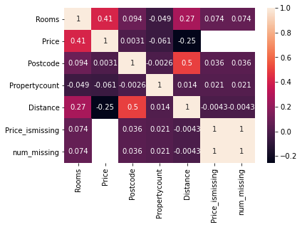
Heatmap shows correlations how strong in between columns. Rooms and price columns correlation is the higher one as expected.

Slide 7
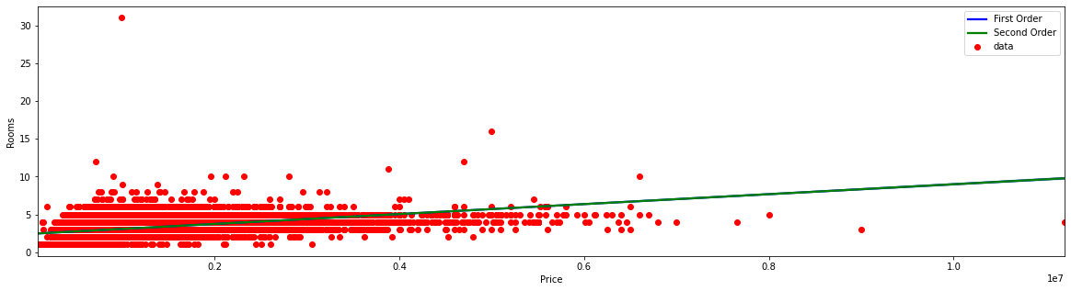
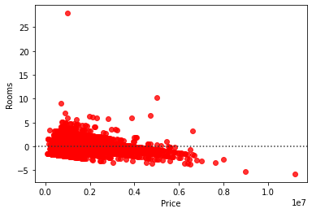
High order regression and residual regression prove how to price range and the number of rooms must be considered for quick sales.

Slide 8
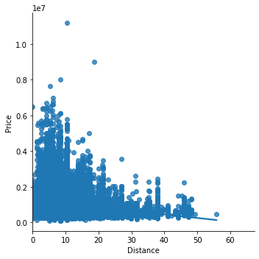
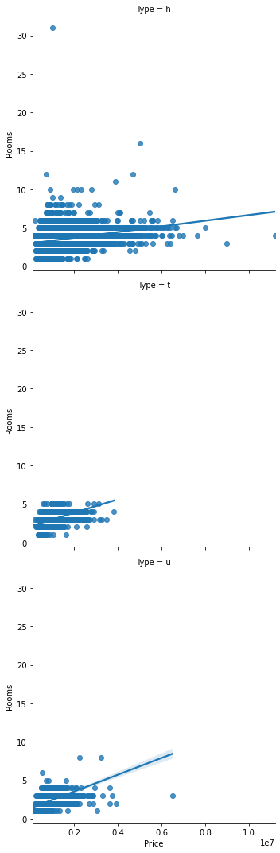
Acquiring data as grouping linear regression by column 'Type’ and ‘Distance’ from python illustrates how location and type information truly to invest.

